Slide 1
DEEP-IMPEX
DEEP-IMPEX Mobile Application
Hotel Industry App

Slide 2
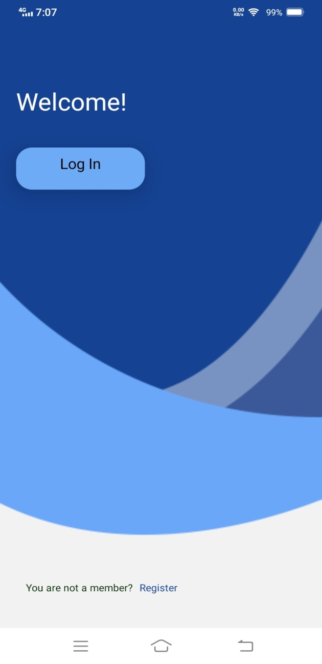
DEEP-IMPEX WELCOME
Login – Owner can directly login with phone number and employee can login themselves if they have account.
Register – Employee need to register account before access the app

Slide 3
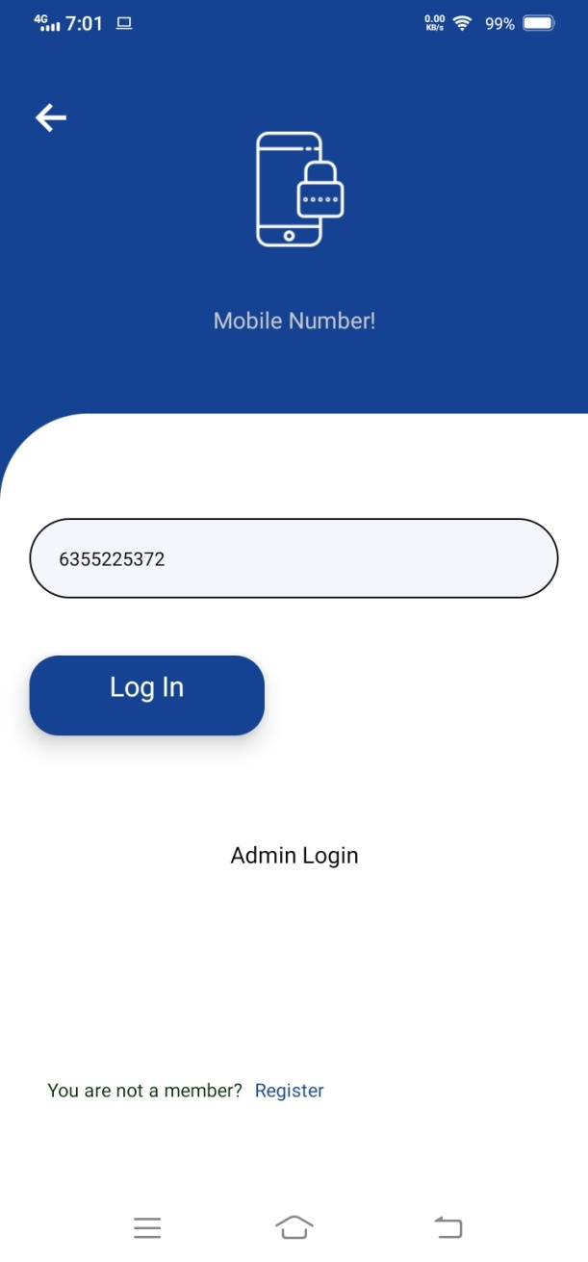
DEEP-IMPEX LOGIN
Log in
If you already registered in the app, then you can simply click on Log In option and enter your mobile number to go inside app.

Slide 4
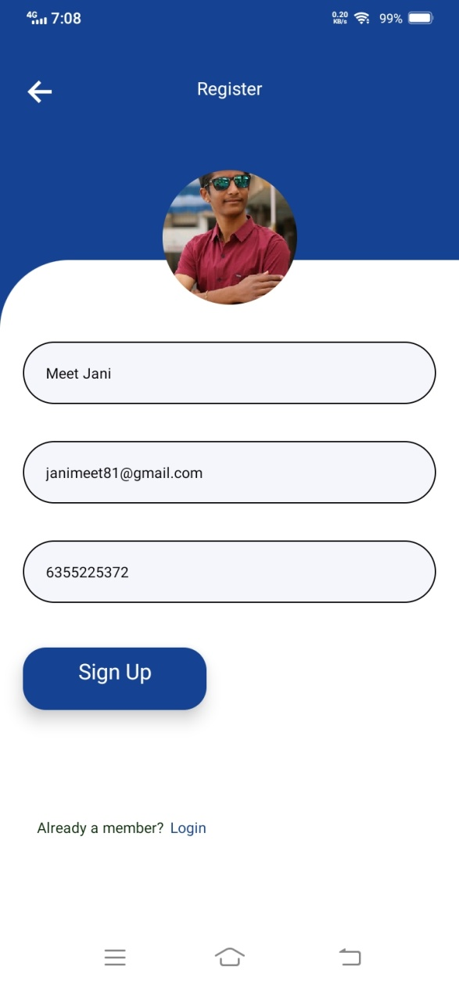
DEEP-IMPEX REGISTRATION
Registration
Enter all the details as mentioned in the form to register inside the application.

Slide 5
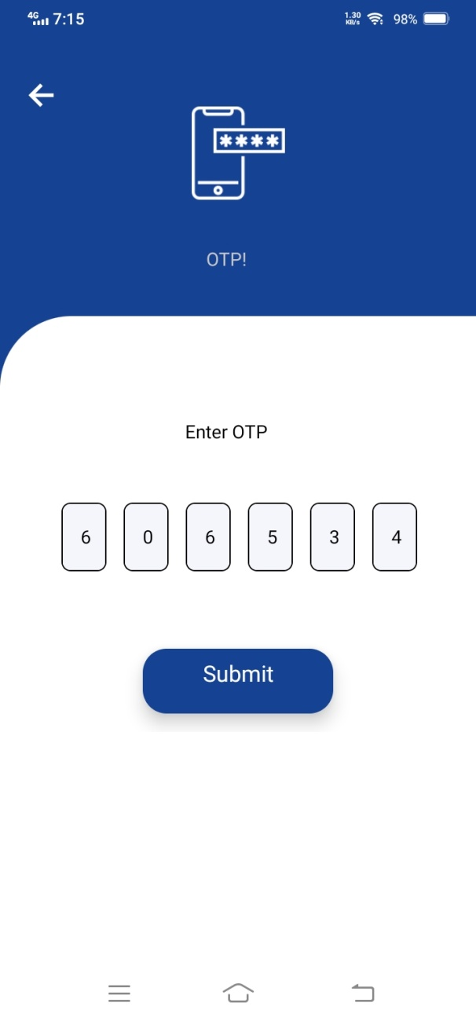
DEEP-IMPEX OTP-VERIFICATION
OTP Verification
You will receive One Time Password via SMS once you entered your mobile number in Log In screen.

Slide 6
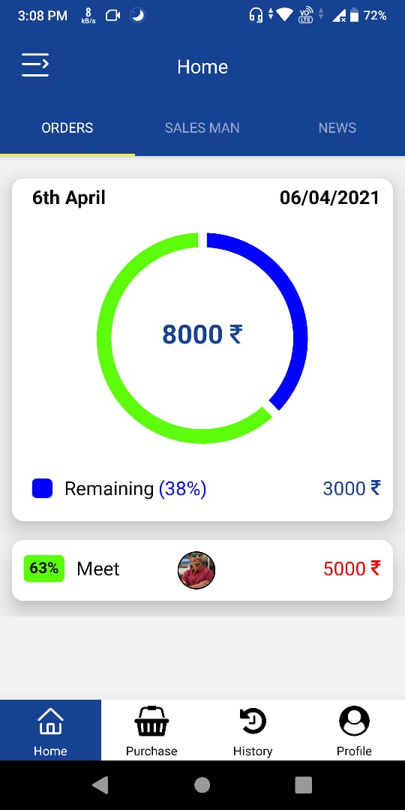
USER HOME
1
ORDER DETAILS – All the information related to current order wallet will display in this section like name, date, total wallet etc.
3
4
1
2
EMPLOYEE DETAILS – All the information about the employees wallet will be list in this section.
3
SALES MAN – In this section, All employees purchase is listed. Employees can check each others purchase by navigating to this screen.
4
NEWS – All the future item purchase is listed in the news screen, which is uploaded by owner.
2

Slide 7
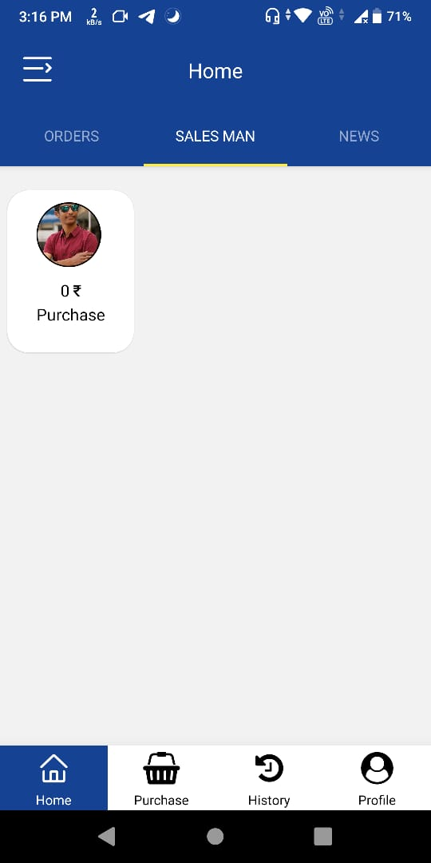
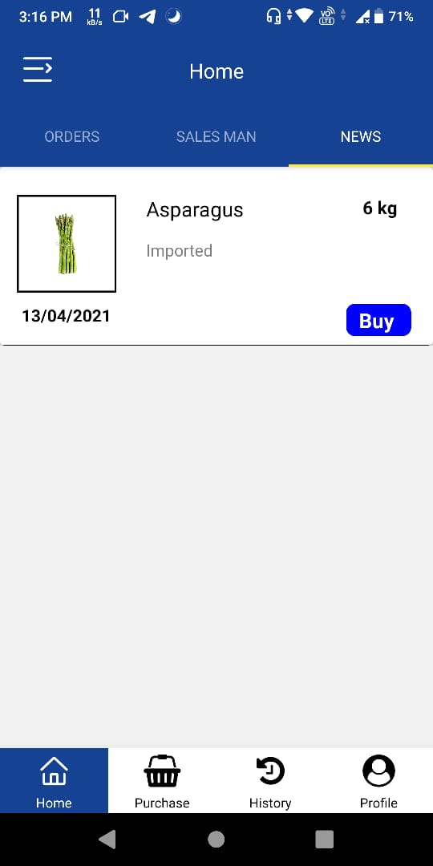
USER HOME
1
EMPLOYEE DETAILS – Employee can check the purchase of other employee as well as check own purchase.
1
2
NEWS PURCHASE – Employee can purchase new items by clicking buy Button.
2

Slide 8
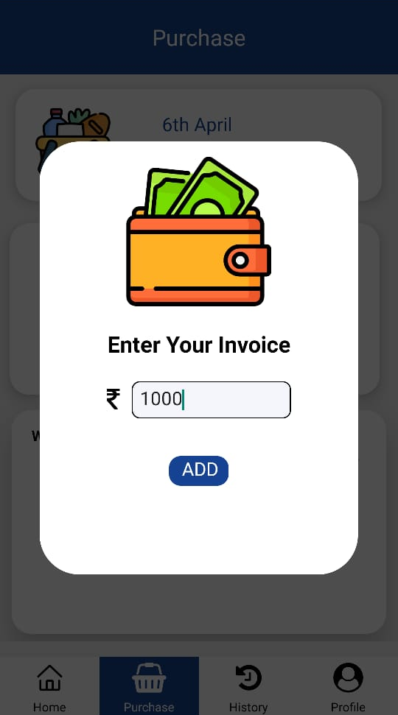
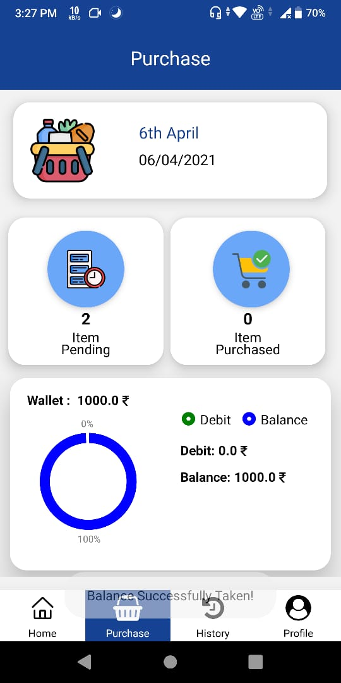
USER PURCHASE
1
WALLET INPUT – Employee have to take balance from main wallet. They can write input in this section.
2
1
2
ORDERS ITEMS – Employee can check all the items and purchase that items by clicking on this section.
3
4
3
PENDING ITEMS – Employee can check all the items which are pending to purchase by clicking to this section.
5
4
PURCHASED ITEMS – Employee can check all the items which are purchased by clicking to this section.
5
WALLET ANALAYTICS – Employee can check their analytic of wallet in this section

Slide 9
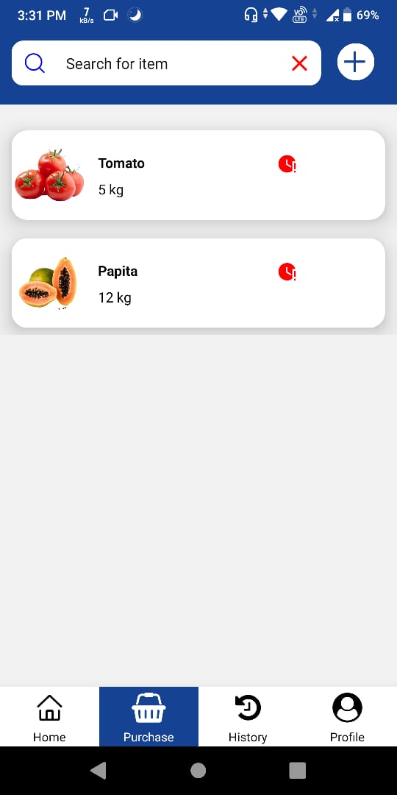
USER PURCHASE
Purchase Item List
Go to Purchase > (Order Name)
Employee can purchase item by clicking a particular item and also add another item by clicking add button on the top. They can also search for particular item in the list.

Slide 10
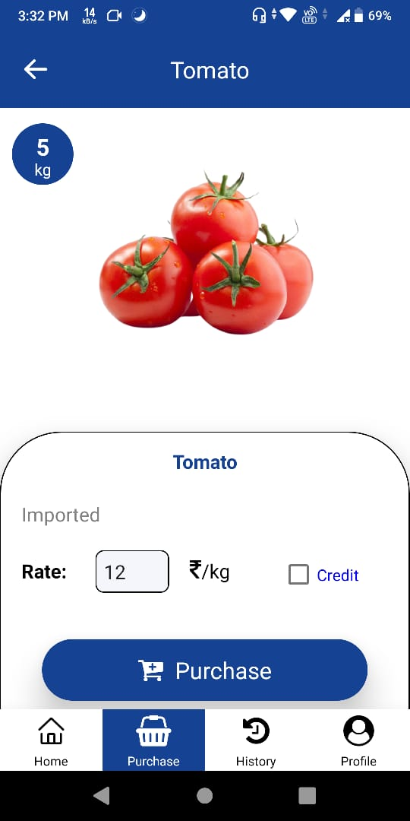
USER PURCHASE
Purchase Item
Go to Purchase > (Order Name) > (Item Name)
Employee have to write the rate of the item for purchasing it. Once they enter the amount next they have to click the purchase button for purchasing it.
Employee can also take the credit if they not have enough balance for purchasing item.

Slide 11
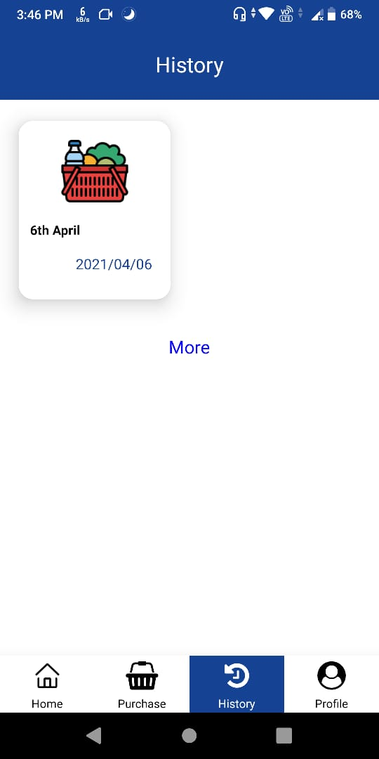
USER HISTORY
History
Employee can see their purchase history order-wise.

Slide 12
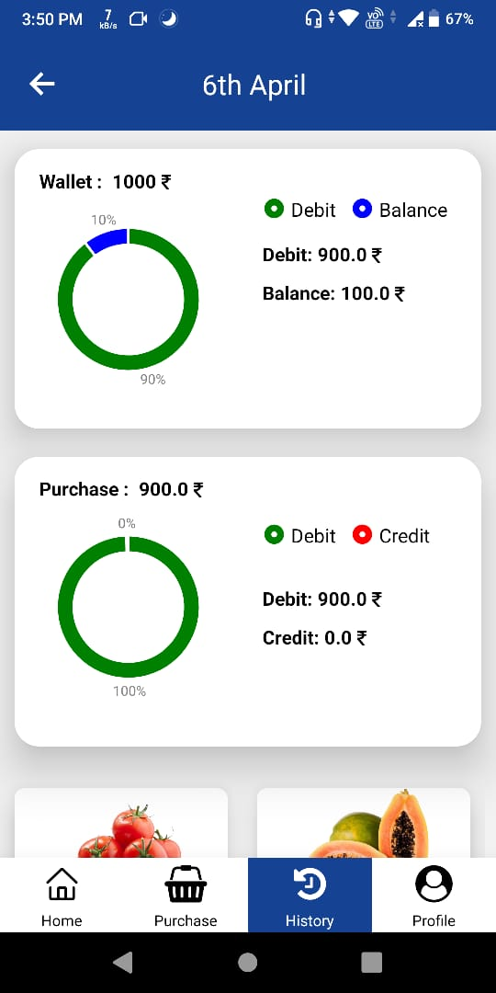
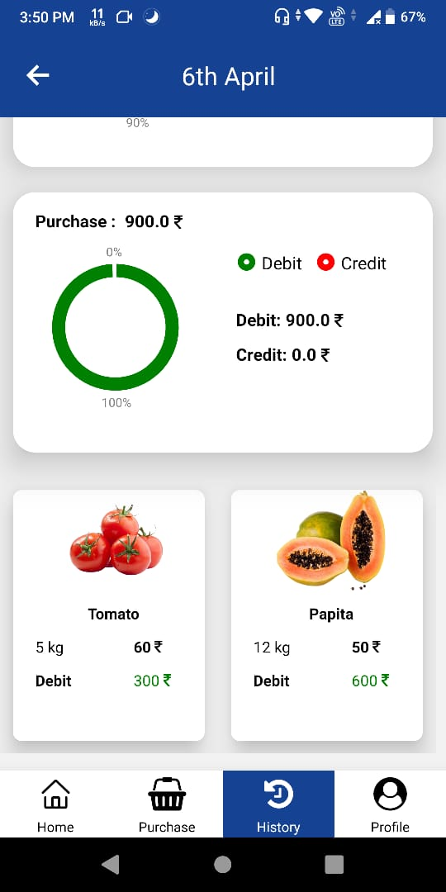
USER HISTORY
Order History
Employee can see their history of order like total purchase, debit, credit, wallet and item which are purchased by them.

Slide 13
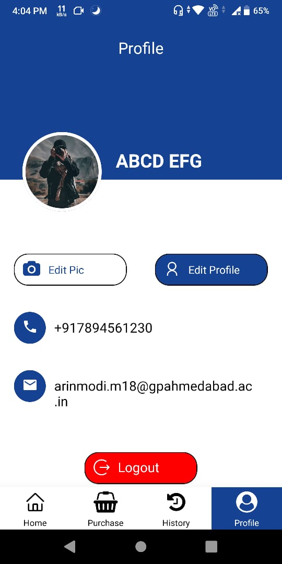
USER PROFILE
Profile
Employee can Edit their profile and logout from account.

Slide 14
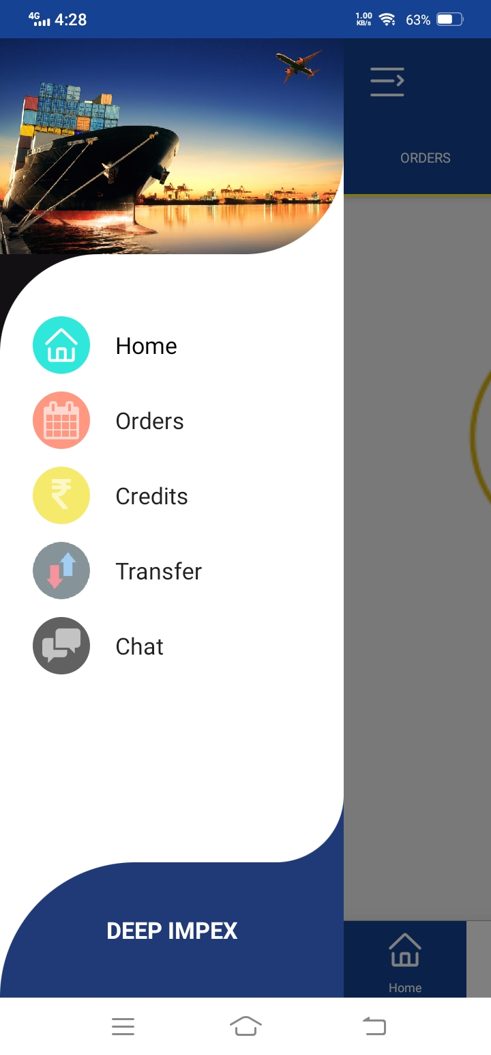
USER MENU
1
Home – Home Screen.
2
Orders – Employee can see future orders.
3
Credits – Employee can check credits and also pay their credits.
1
2
4
Transfer – Employee can transfer balance to another employee.
3
5
Chat – Group Chat.
4
5

Slide 15
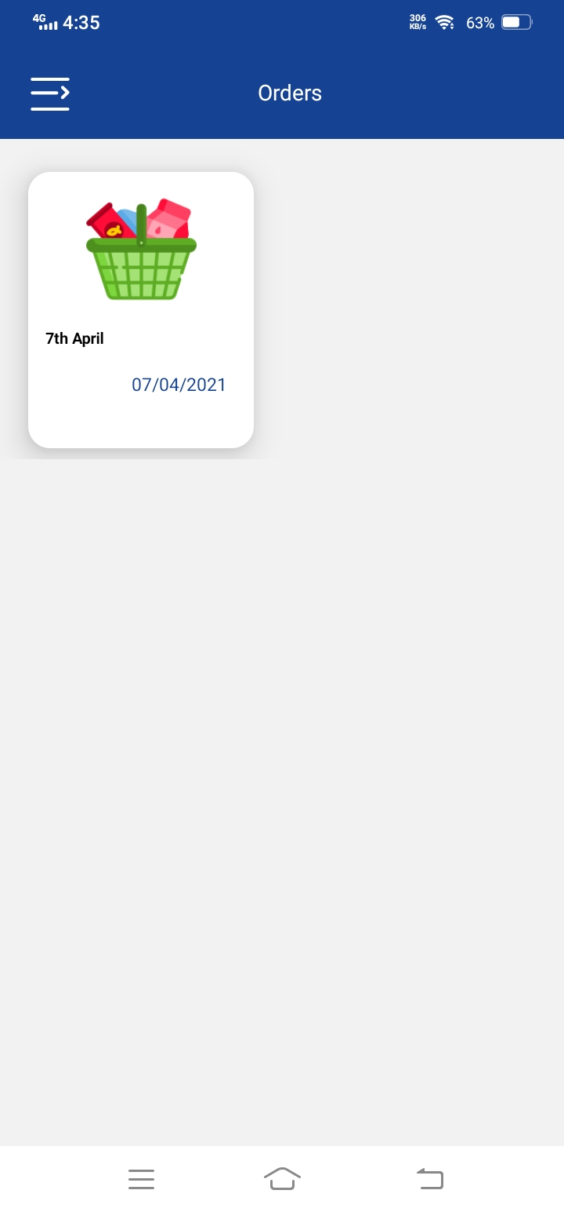
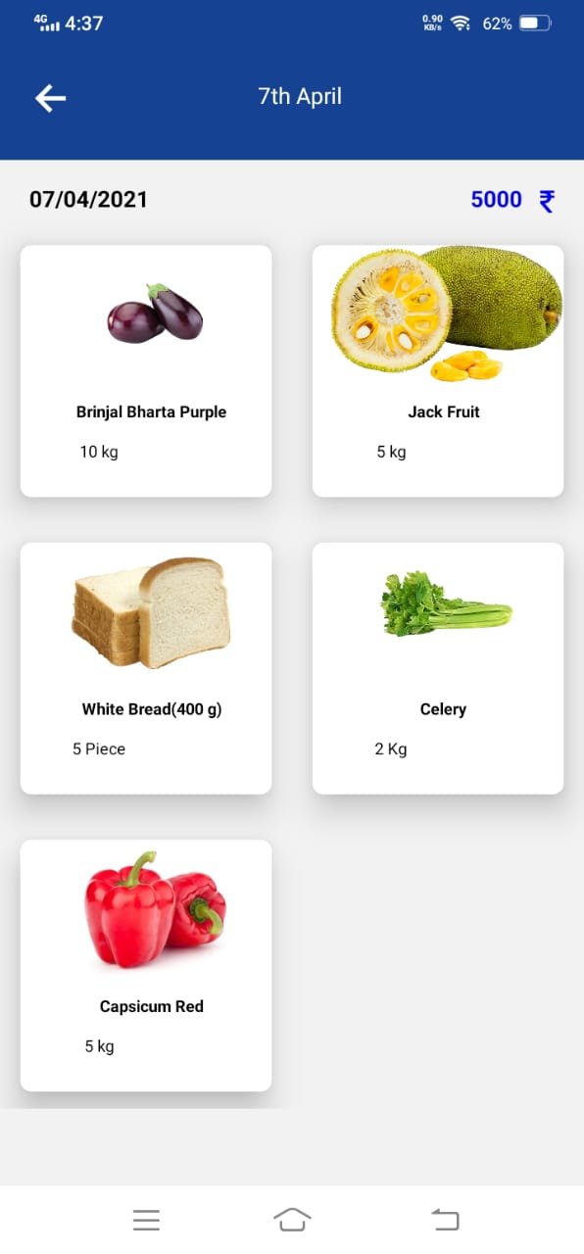
USER-ORDER
1
Orders – All the future orders is listed here as shown in screen.
1
2
Order Items – employee can check order items.
2

Slide 16
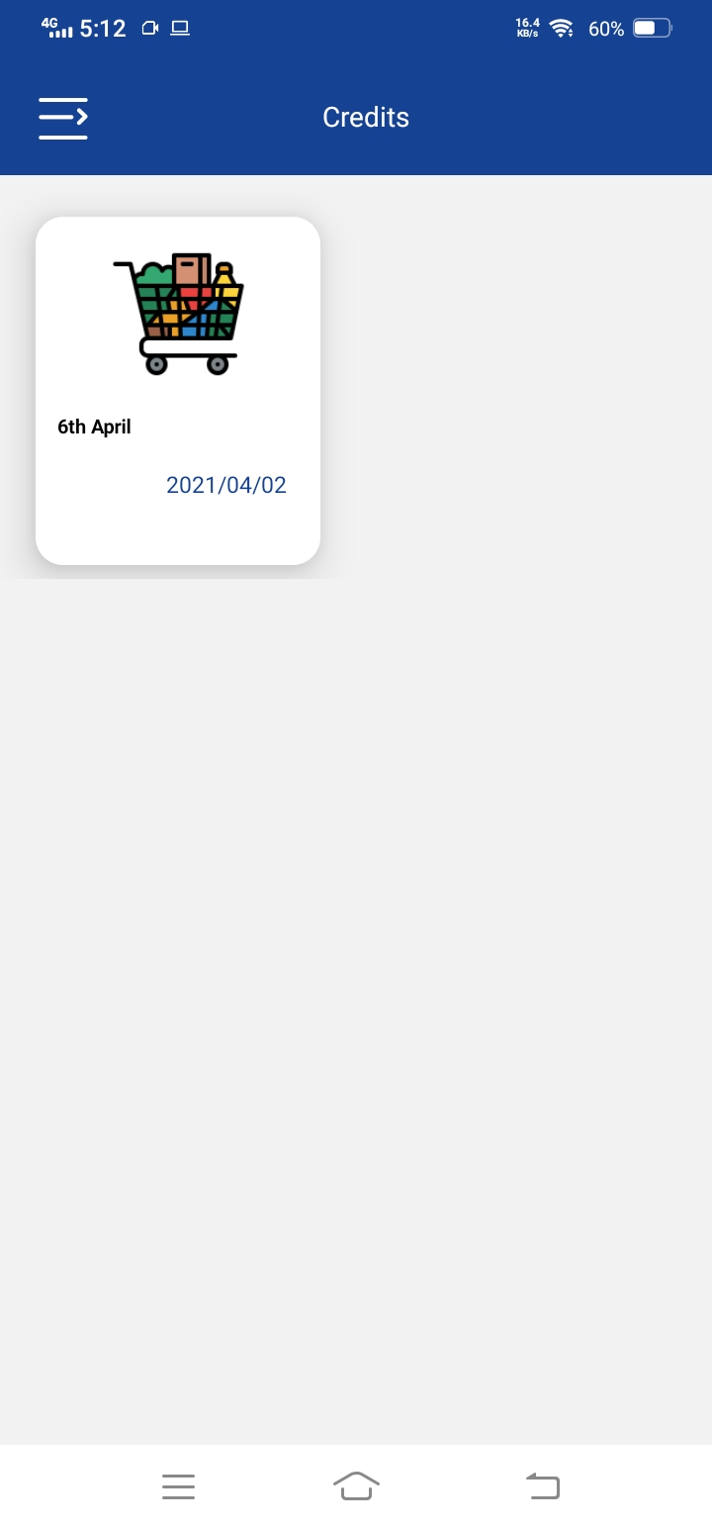
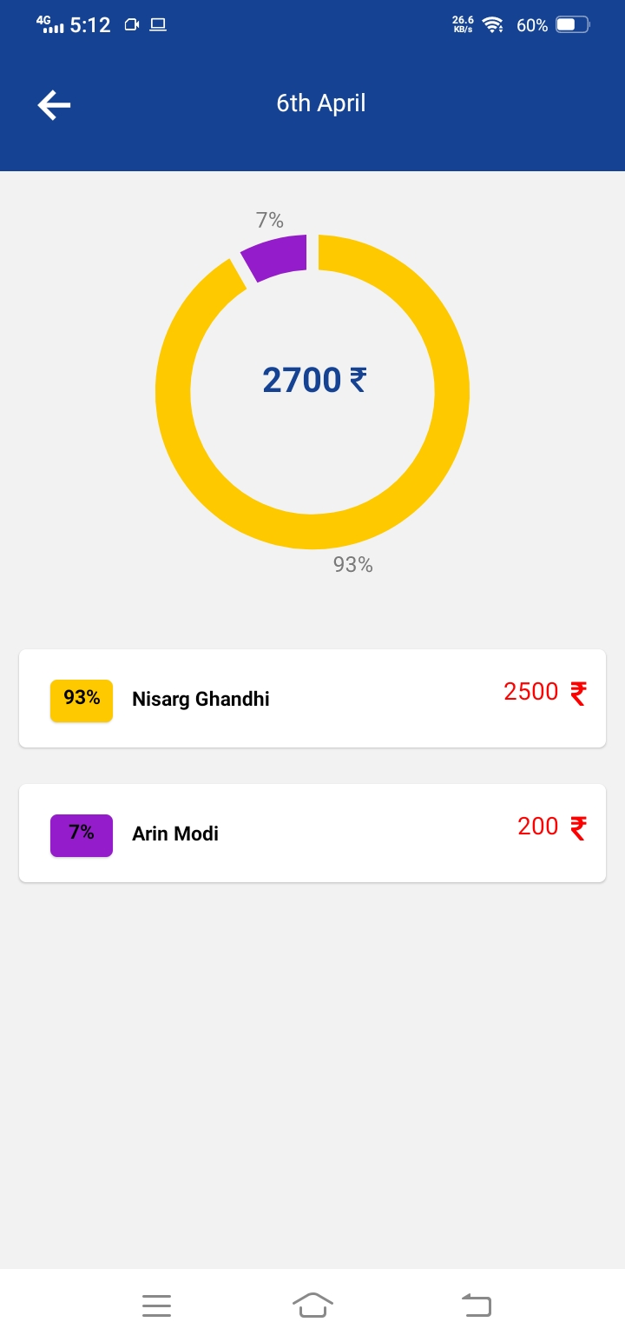
USER-CREDITS
Credits
Employee can check their credits which are remaining to pay.
They can see the analytics of their credits.
Employee can pay the credit by clicking on particular person credit

Slide 17
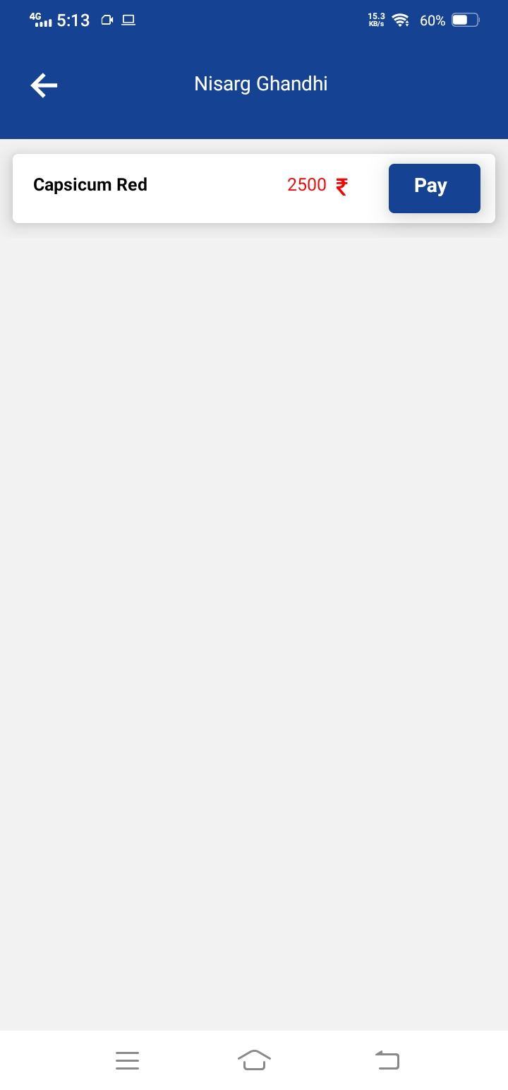
USER-CREDITS
Credits Pay
In this screen, Employee can pay their credit by clicking on Pay button

Slide 18
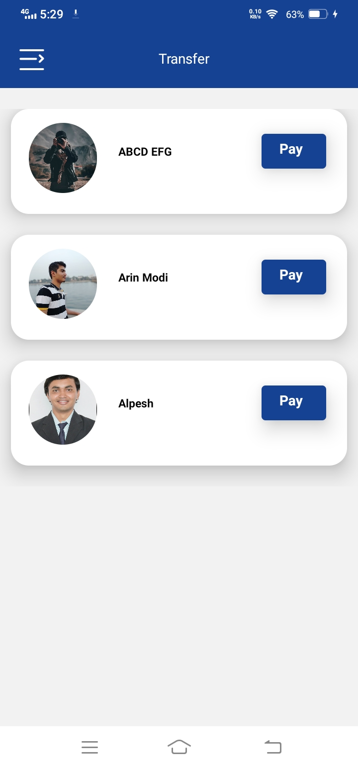
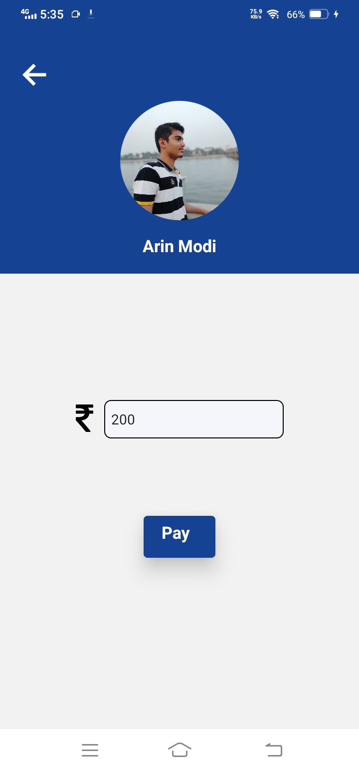
USER-TRANSFER
Balance Transfer
In this screen, Employee can transfer balance to another employee

Slide 19
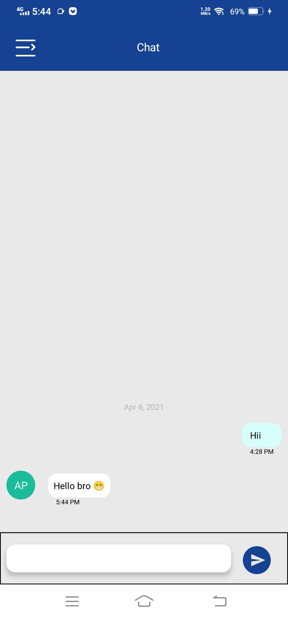
USER-CHAT
Chat
Group chat. Employees and owner can chat in group.

Slide 20
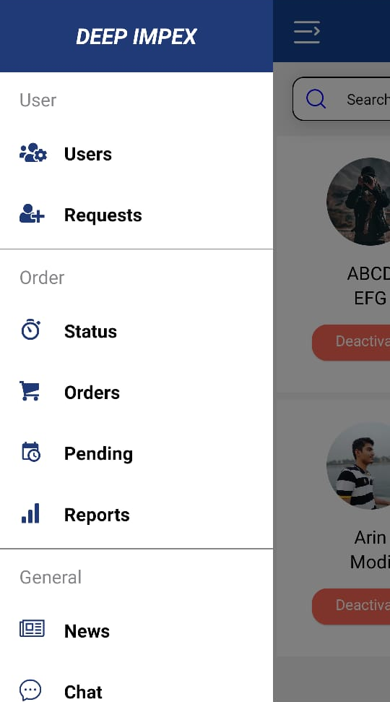
Admin-MENU
1
Users – User Management.
2
Requests – User Requests.
1
2
3
Status – Current Order Status.
4
Orders – Orders Management Screen.
3
4
5
Pending – Pending Items List.
5
6
Reports – Reports List & Generation.
6
7
News – News Management Screen.
7
8
8
Chat – Group Chat.

Slide 21
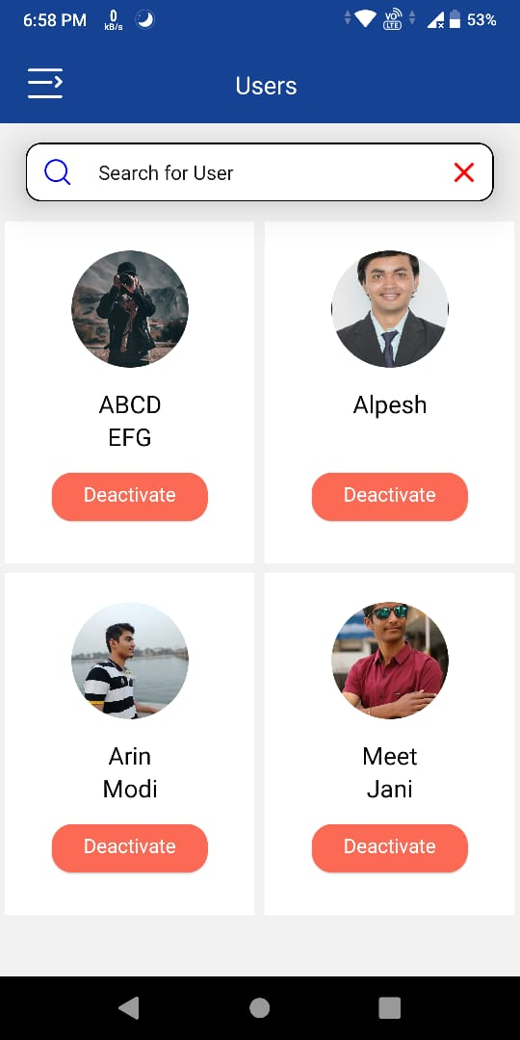
Admin-USERS-SCREEN
User Management
Admin can manage their employee account.
Admin Can deactivate and activate employee account.

Slide 22
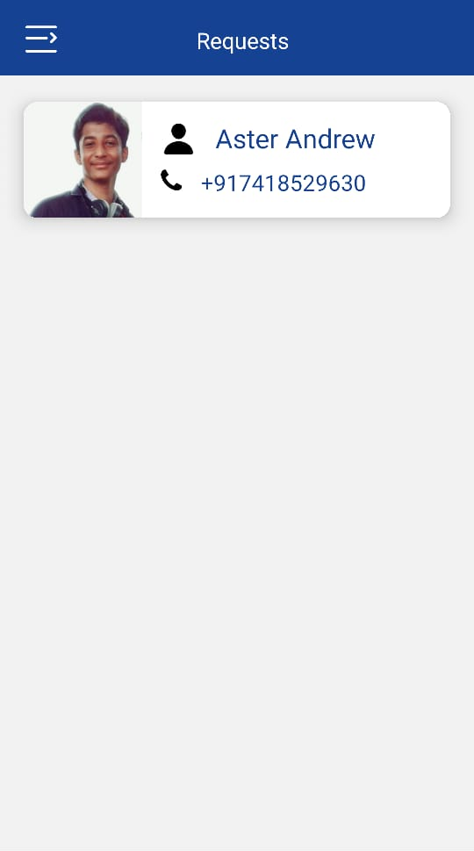
Admin-USER_REQUEST
Requests
In this screen, admin can check the all pending request for accessing app. Admin can deny and submit employee requests by clicking on particular employee request.

Slide 23
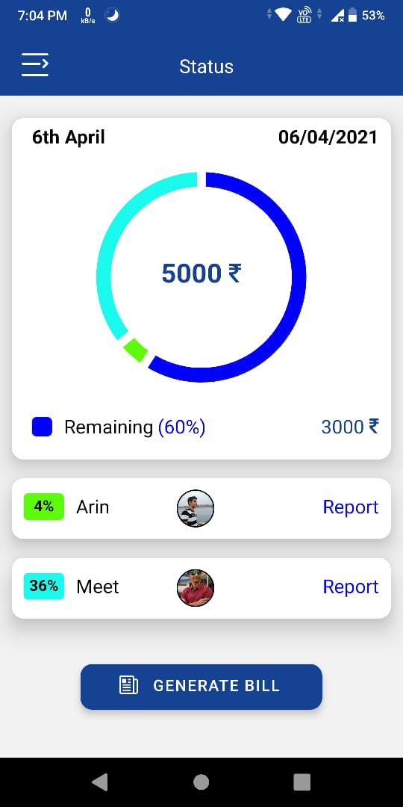
Admin-ORDER_STATUS
Status
Admin can check the current order status and generate bill for today’s order by clicking on GENERATE BILL button.
Admin can also generate bill of particular employee by clicking on Report button.

Slide 24
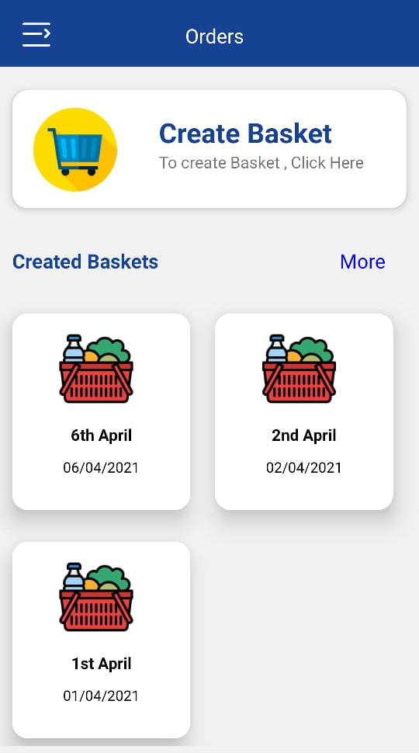
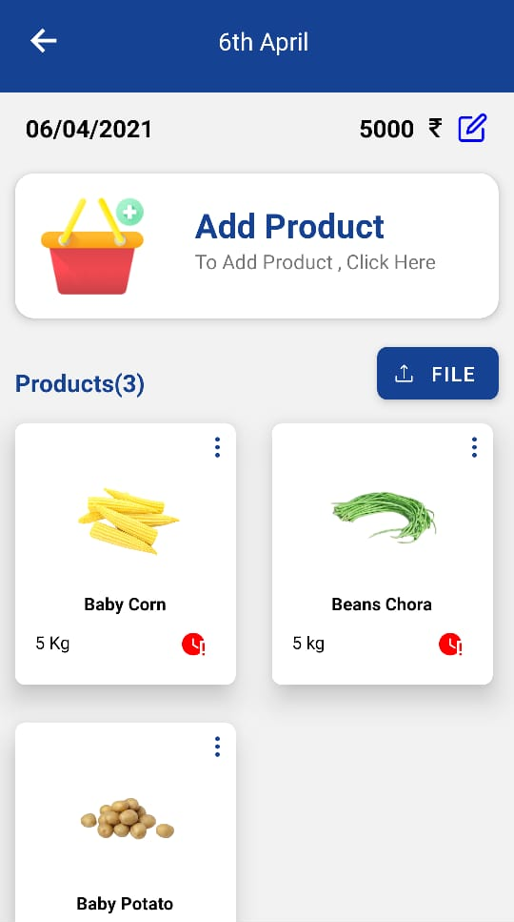
1
Admin-ORDERS
1
Order Creation.
4
1
2
Previous Orders.
5
3
Latest Order List.
2
3
4
Particular One Order Detail and products.
6
7
8
5
Adding new Product.
6
Products count.
9
7
File Upload.
8
Products List & details.
9
Product status pending or purchased.

Slide 25
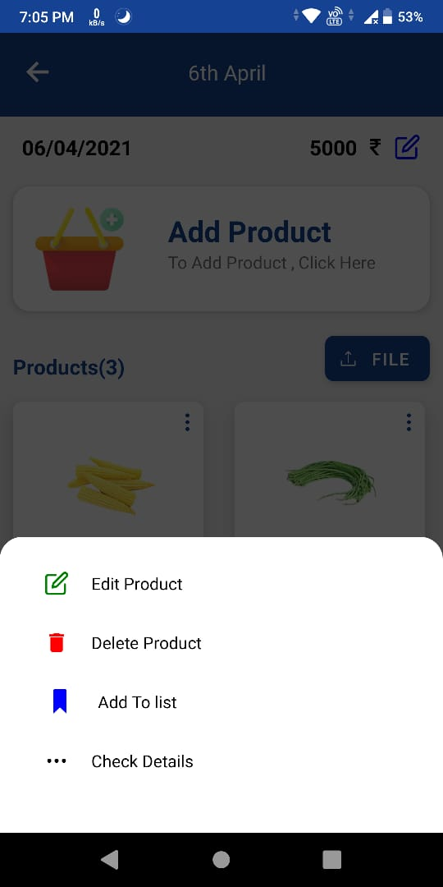
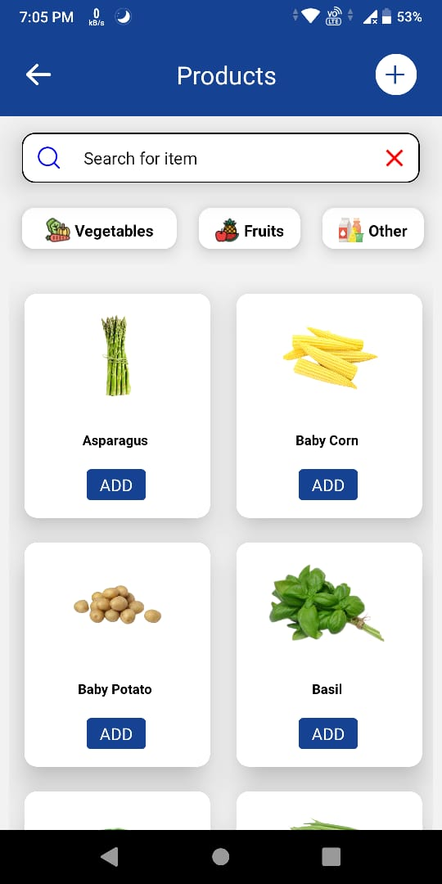
Admin-ORDERS
1
Product details
2
Admin can edit, delete, save and check details of one product in the list by clicking on more icon in the product list.
2
Add Products
Admin can add products in the order from this screen. Admin can search for particular product in the search box. He/she can also filter the products by category.
Admin can add product in the order by clicking on Add button
1

Slide 26
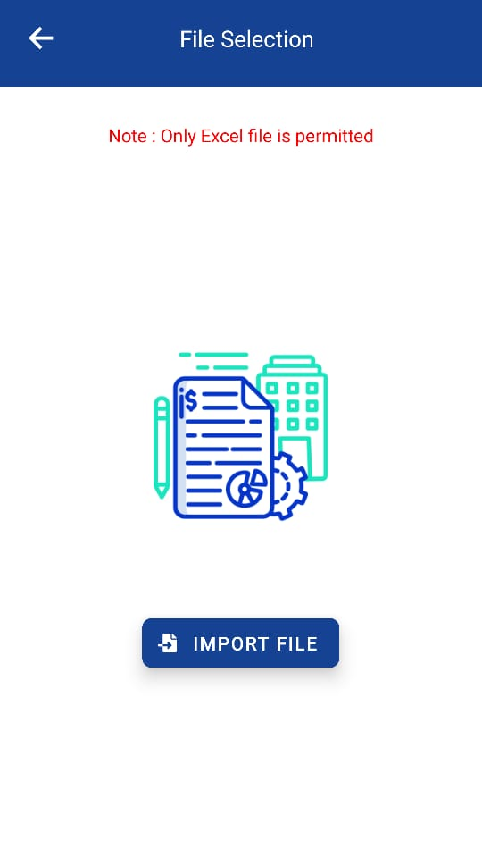
Admin-ORDERS
File selection
Admin can also add products by file. If they already created the file for products then they can easily upload file and add products in the order.
Admin can select file by clicking on IMPORT FILE button.

Slide 27
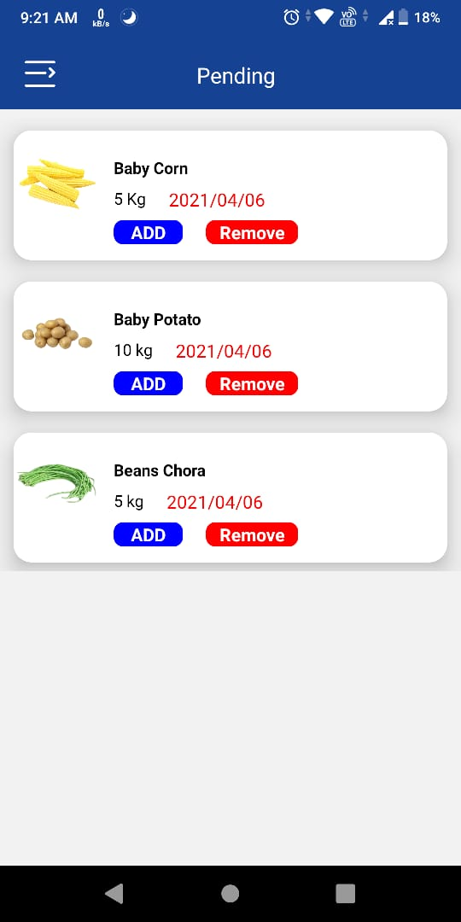
Admin-Pending
Pending Products
Admin can add pending products by clicking on ADD button or remove it also.

Slide 28
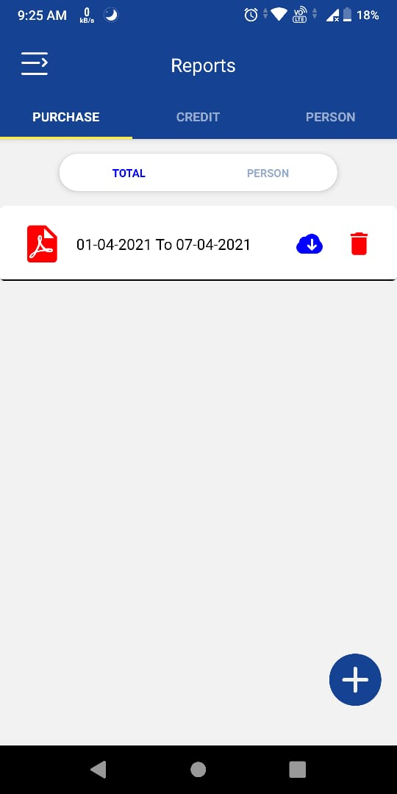
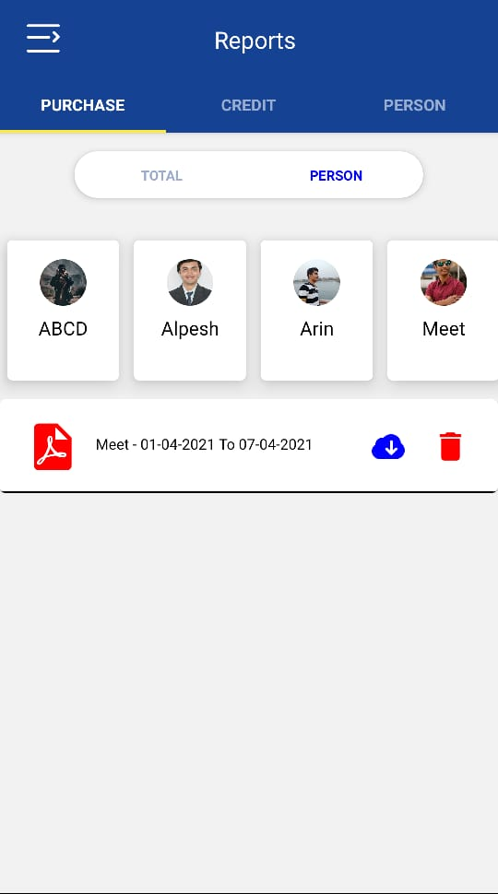
Admin-Reports
Purchase Reports
Admin can create the report of company’s total purchase by selecting dates.
Admin have to click on add button for creating report.
Admin can also generate report of employee purchase by selecting one employee.
Admin can view this report by clicking on the report.
Admin can also download and delete this reports

Slide 29
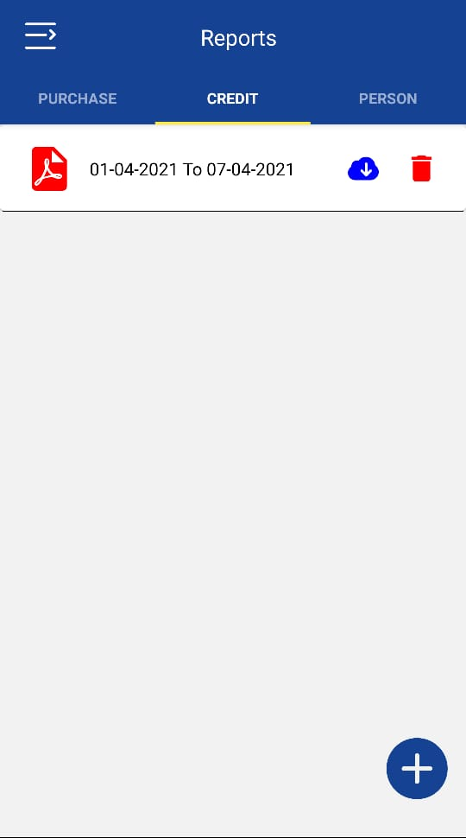
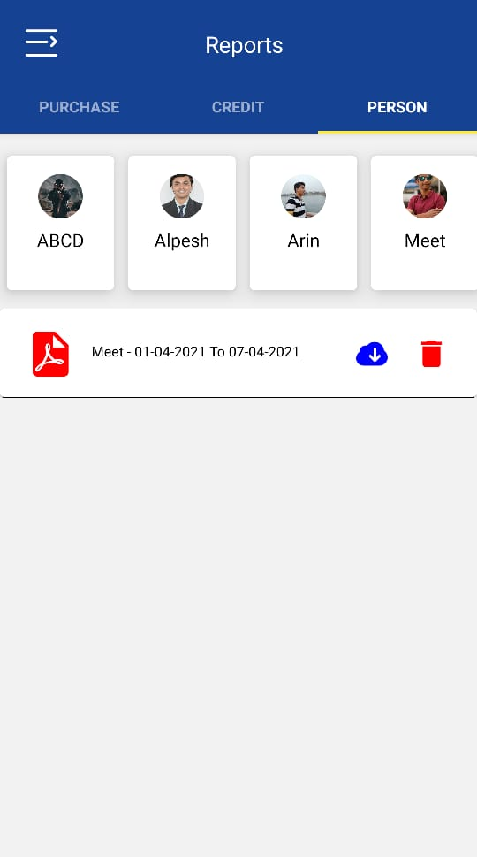
Admin-Reports
Credits Reports
Admin can create the report of company’s total credit by selecting dates.
Admin have to click on add button for creating report.
Admin can also generate report of employee credit by selecting one employee in the person tab.
Admin can view this report by clicking on the report.
Admin can also download and delete this reports

Slide 30
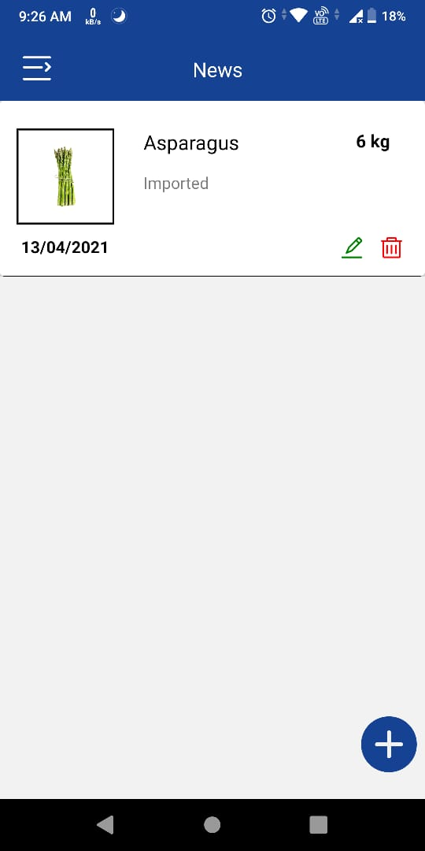
Admin-News
News Management
Admin can manage news in this screen. Admin can add news by clicking on add button.
Admin can edit particular news details and also delete the news

Slide 31
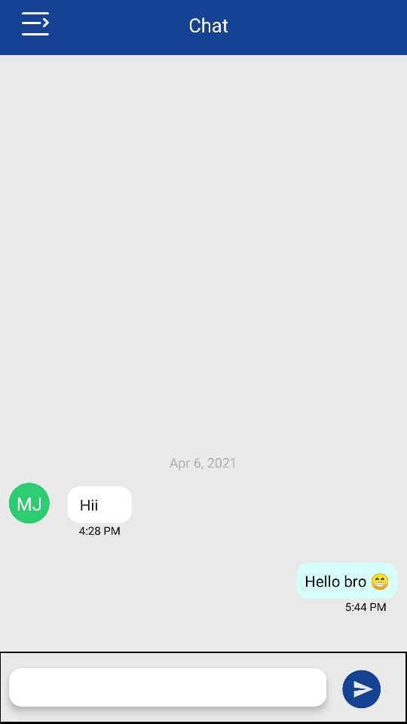
Admin-Chat
Chat
Admin can chat with employees using this module.

